Slide 1
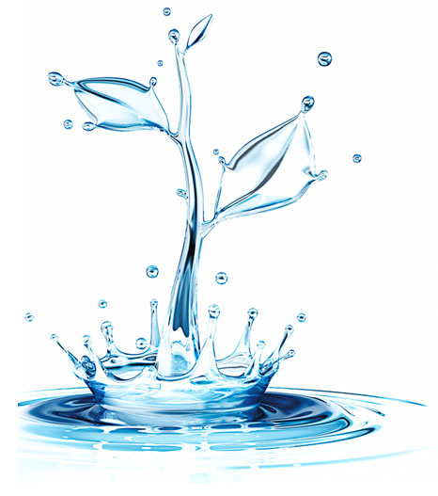
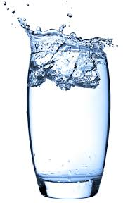
Water World
L/O: To be able to locate where are drinking water comes from and how important the water cycle is.
To know where water is found and what it comprises of.
Starter:
Make a spider diagram or list of all different ways we use water on a daily basis.
To be able to label and explain the hydrological cycle.
To understand the links between the hydrosphere, lithosphere and biosphere.

Slide 2
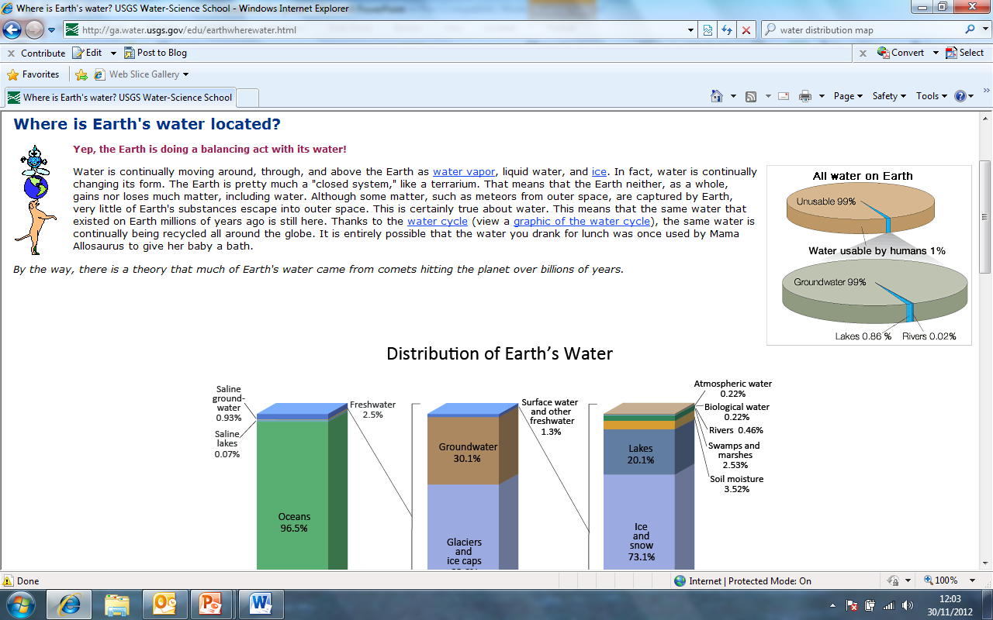
What is the definition of water?
Crack the code…
Using the coded alphabet on your worksheet, discover the definition of water.
Once you have completed the task, you then need to write the definition neatly in your book under heading in the pink box above.

Slide 3
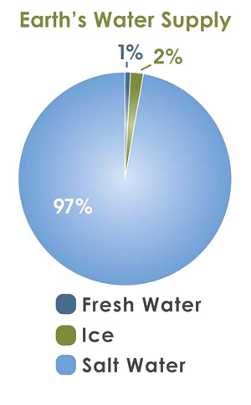
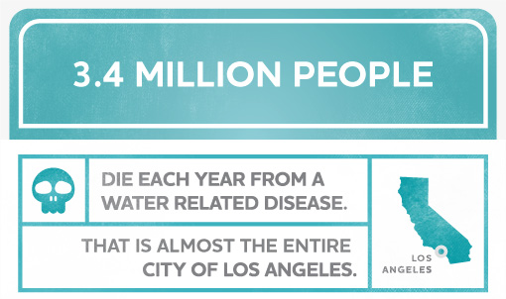
What is the definition of water?
A colourless, tasteless, transparent, odourless liquid that forms the seas, rivers and rain.
Or half the amount of people who live in London!

Slide 4
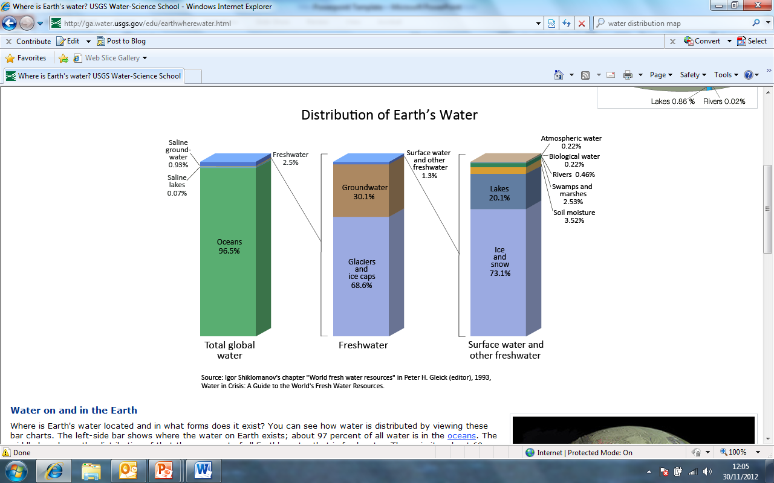
Where is water found?

Slide 5
Task
You need to draw 3 bar graphs showing the compounds of water – similar to the one we have just been looking at.
Bar 1 | Bar 2 (of fresh water) | Bar 3 (of surface water)
Fresh Water – 3% | Ice – 79% | Lakes – 52%
Salt Water – 97% | Underground – 20% | Soil – 38%
 | Surface 1% | Atmosphere – 8%
 |  | Rivers – 1%

Slide 6
The Hydrological Cycle
The hydrological cycle is the movement of water around the atmosphere, sea and ground in a continuous cycle.
We call this a system. What three key things create a system?
Inputs
Processes
Outputs

Slide 7
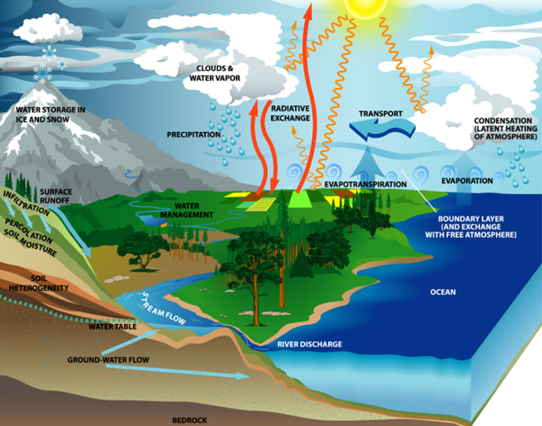
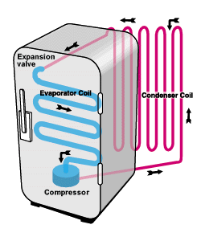
Water – A Continuous Cycle
Water flows in a never ending cycle between the atmosphere, land and oceans.
No water is gained, and no water is lost in this cycle.
Imagine it to be like your heating system at home travelling round your house.
What kind of cycle do we call this?

Slide 8
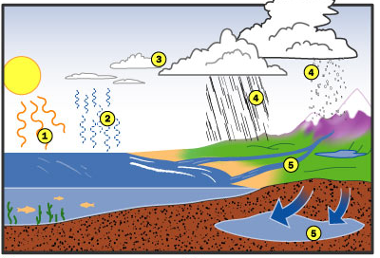




The Water Cycle
On your worksheet is the picture below and some statements. Cut the picture out and stick this is the middle of clean new page (landscape) and cut the statements out.
Using your own knowledge and the textbook to help you need to put the statements with the correct number on your picture.

Slide 9
The Water Cycle – The Answers
Stick these down now in the correct place now.

Slide 10
TASK
Condensation
When water changes from a liquid to vapour.
Evaporation
When cooling vapour turns into a liquid.
Surface runoff
Water that falls on the earth’s surface (rain, snow).
Precipitation
Movement of water over the land (river).
Groundwater
Plants giving off water vapour from their leaves.
Transpiration
Water that has sunk through the ground to the rocks below.
Match up the definitions with the statements – write them neatly into your book (E/D Grade)
What 3 states can water be found? (C Grade)
Using page 58, give reasons why water changes state throughout the water cycle. (Grade B)

Slide 11
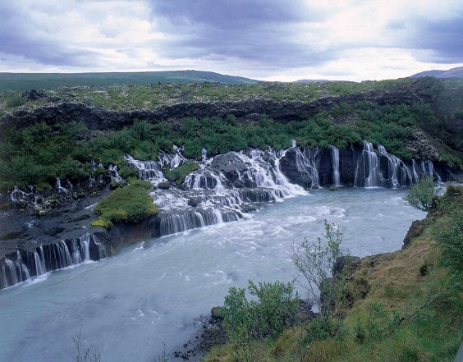
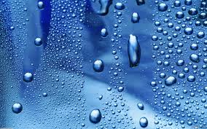
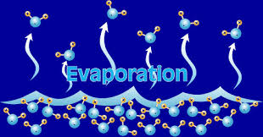
Mix and Match – The Answers
Condensation
When cooling vapour turns into a liquid.
Evaporation
When water changes from a liquid to vapour.
Surface runoff
Movement of water over the land (river).
Precipitation
Water that falls on the earth’s surface (rain, snow).
Groundwater
Water that has sunk through the ground to the rocks below.
Transpiration
Plants giving off water vapour from their leaves.

Slide 12
